Slide 1

Advanced Programming

Slide 2

Hello!
I am Xuan Truong
I am here to present you about the Singleton Pattern for my application and its advantages in the project.

Slide 3
Singleton Pattern
1

Slide 4
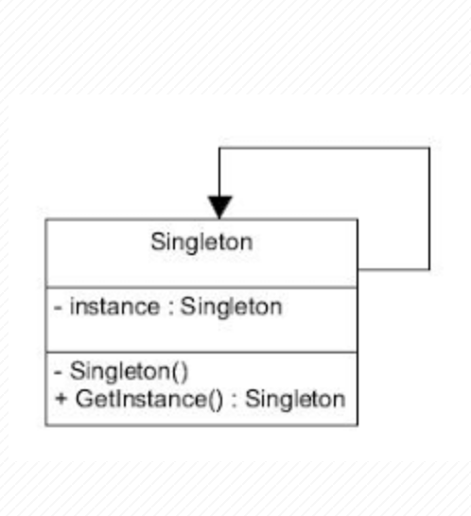
Overview
Singleton is a creational design pattern that lets you ensure that a class has only one instance and provide a global access point to this instance.
Singleton is one of the 5 design patterns of the Creational Design Pattern group .
Singleton ensures only one instance (instance) is created and it will provide you with a method to be able to access that unique instance anytime, anywhere in the program.

Slide 5
Usage and implement of Singleton Pattern
2

Slide 6
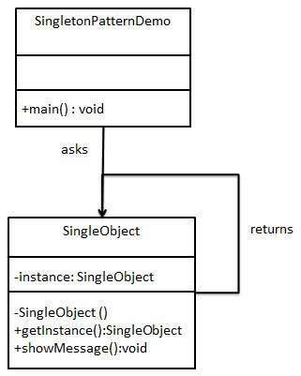
Usage of Singleton
Use Singleton when we want:
Make sure that there is only one instance of the class.
Better access management because there is only one instance.
The number of instances of a class can be managed within a specified limit.

Slide 7

Implement Singleton
There are many ways to implement the Singleton Pattern. But no matter how the implementation is based on the following basic principles below
private constructor to restrict access from outside class.
Setting a private static final variable ensures the variable is initialized only within the class.
There is a public static method to return the instance initialized above.

Slide 8
Ways to implement
Eager initialization
Static block initialization
Lazy Initialization
Thread Safe Singleton
Double Check Locking Singleton
Bill Pugh Singleton Implementation
Breaking the Singleton Pattern with Reflection
Enum Singleton
Serialization and Singleton

Slide 9
Implement Singleton Pattern to application
3

Slide 10

Description
The application is designed for a school with 2 main roles student and staff ( teacher or admin)
4 functions appear in system are: Add, Read, Delete, Modify
As student, users can read and modify their information
As staff they can do anything

Slide 11
Using Singleton in application
Because this application – Student Management System only exists 1 Instance
Another reason singleton should be used when managing access to a resource which is shared by the entire application.

Slide 12
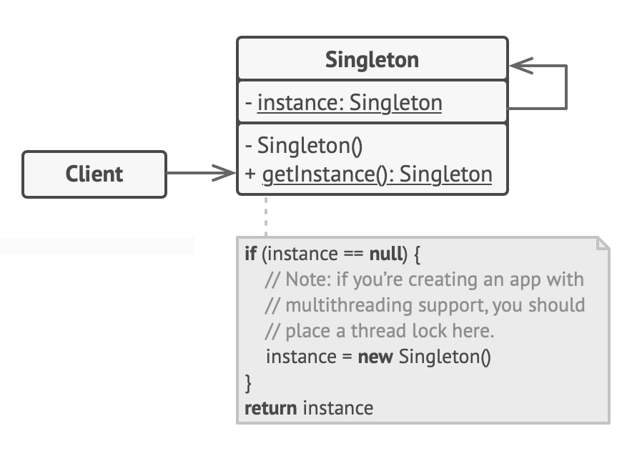
Structure

Slide 13
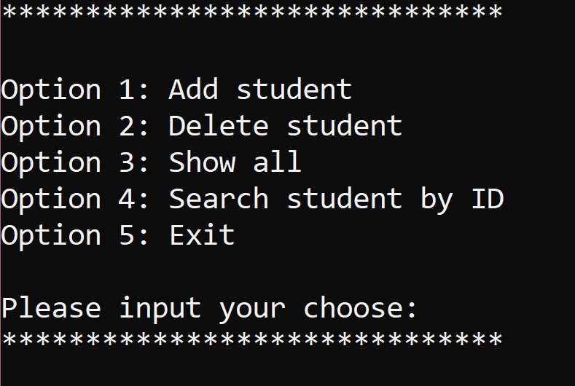
Menu options

Slide 14

Thanks!
Any questions?

